Slide 1
DATA VISUALIZATION
23/03/2022

Slide 2
SEMIOLOGY OF GRAPHICAL SYMBOLS
We consider a visual object called a graphical symbol. Figure 4.4 is an example. Such symbols are easily recognized.
They often make up parts of visualizations (arrows, labels, . . . ).
We will look at how a graphical object or representation can be well designed, and how it is perceived.
The science of graphical symbols and marks is called semiology.

Slide 3
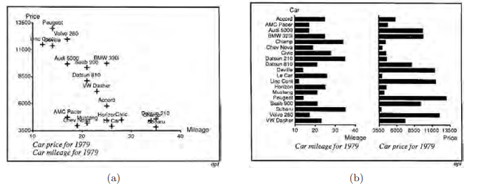
SEMIOLOGY
(a) Scatterplot using plus as symbol provides good query-answering capabilities, but is slower for simple one variable queries. (b) Bar charts clearly display cost and mileage, but don’t provide as much flexibility in answering some other queries.

Slide 4
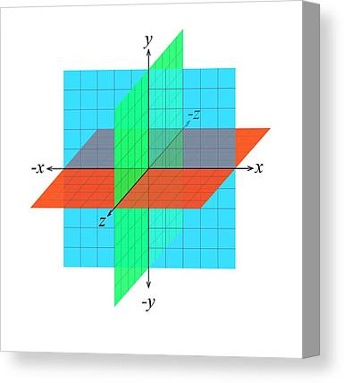
CONTD.
Every possible construction in the Euclidean plane is a graphical representation made up of graphical symbols.
This includes diagrams, networks, maps, plots, and other common visualizations. Semiology uses the qualities of the plane and objects on the plane to produce similarity features, ordering features, and proportionality features of the data that is visible for human consumption.
There are numerous characteristics of visualizations, of images, or of graphics made up of symbols. We describe some of these in the following sections.

Slide 5
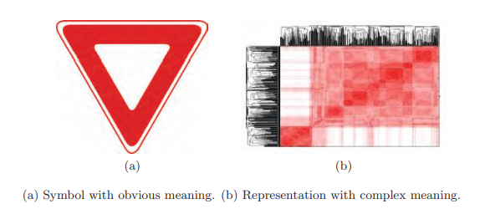
SYMBOLS AND VISUALIZATION

Slide 6
CONTD.
Figure a) contains an image that is universally recognizable (yield sign). Such images become preattentively recognizable with experience.
Figure (b), on the other hand, requires a great deal of attention to understand; the first steps are to recognize patterns within that figure.
Figure (a) is perceived in one step, and that step is simply an association of its meaning.
Figure (b) takes two steps for understanding.

Slide 7
CONTD.
First identifies the major elements of the image, with the second identifying the various relationships between these. With attentive effort, the symbols are perceived (transferred from long-term memory).
Patterns, mostly subsets of groups or information having perceptual or cognitive commonality, are extracted from the overall image.
The last step is identifying the most interesting things (such as the most interesting point clusters, genes, countries, or products), that is, those having the most interesting or special features.

Slide 8
EXTERNAL COGNITION
Important: Without external (cognitive) identification, a graphic is unusable.
The external identification must be directly readable and understandable.
Since much of our perception is driven by physical interpretations, meaningful images must have easily interpretable x-, y-, and z-dimensions and the graphics elements of the image must be clear

Slide 9
8 Visual Variables
POSITION
MARK
SIZE (LENGTH, AREA, VOLUME)
BRIGHTNESS
5. COLOR
6. BRIGHTNESS
7. ORIENTATION
8. TEXTURE

Slide 10
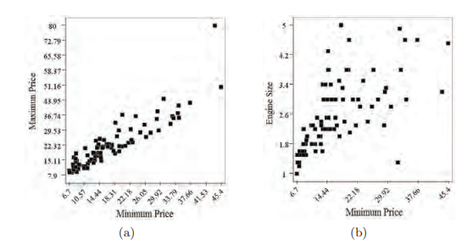
POSITION
The first and most important visual variable is that of position, the placement of representative graphics within some display space, be it one-, two-, or three-dimensional.
In addition to selecting appropriate variables to organize the display space and to present values with representative graphics, scales can be applied to variables to remap values to reveal structures.

Slide 11
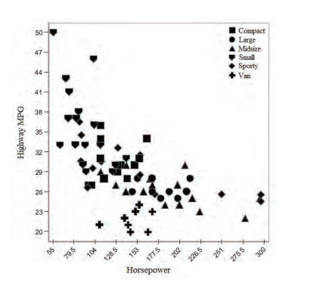
MARK
The second visual variable is the mark or shape: points, lines, areas, volumes, and their compositions. Marks are graphic primitives that represent data.
This visualization uses shapes to distinguish between different car types in a plot comparing highway MPG and horsepower. Clusters are clearly visible, as well as some outliers.

Slide 12
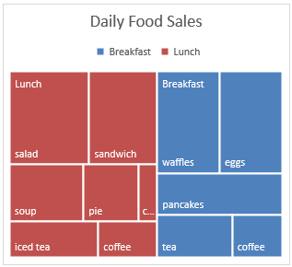
SIZE
The previous two visual variables, position and marks, are required to define a visualization. Without these two variables there would not be much to see.
The remaining visual variables affect the way individual representations are displayed; these are the graphical properties of marks other than their shape.
The third visual variable and first graphic property is size. Size determines how small or large a mark will be drawn

Slide 13

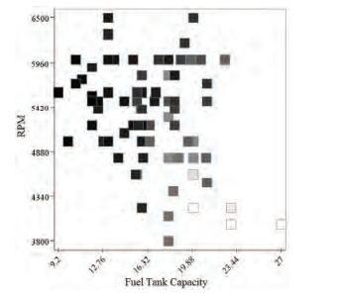
BRIGHTNESS
The fourth visual variable is brightness or luminance. Brightness is the second visual variable used to modify marks to encode additional data variables.
While it is possible to use the complete numerical range of brightness values, Human perception cannot distinguish between all pairs of brightness values.
Consequently, brightness can be used to provide relative difference for large interval and continuous data variables,
Another visualization of the 1993 car models data set, this time illustrating the use of brightness to convey car width (the darker the points, the wider the vehicle).

Slide 14
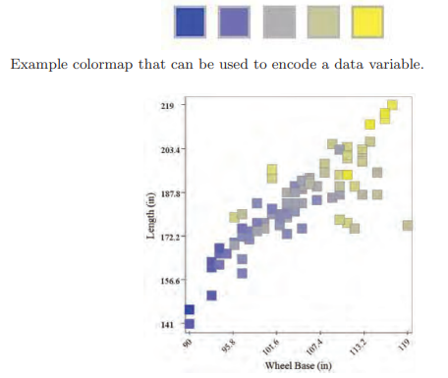
COLOR
While brightness affects how white or black colors are displayed, it is not actually color. Color can be defined by the two parameters, hue and saturation.
A visualization of the 1993 car models, showing the use of color to display the car’s length. Here length is also associated with the y-axis and is plotted against wheelbase. In this figure, blue indicates a shorter length, while yellow indicates a longer length

Slide 15
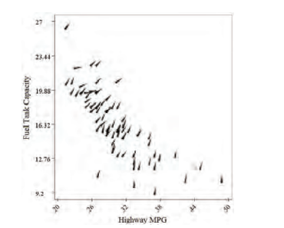
OREINTATION
Orientation is a principal graphic component behind iconographic stick figure displays and is tied directly to preattentive vision. This graphic property describes how a mark is rotated in connection with a data variable.
mple visualization of the 1993 car models data set depicting using highway milesper-gallon versus fuel tank capacity (position) with the additional data variable, midrange price, used to adjust mark orientation.

Slide 16
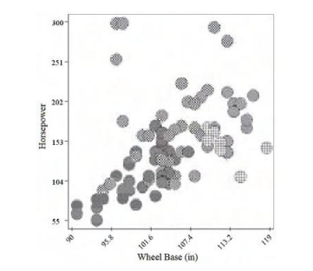
TEXTURE
he seventh visual variable is texture. Texture can be considered as a combination of many of the other visual variables, including marks (texture elements), color (associated with each pixel in a texture region), and orientation (conveyed by changes in the local color).
Dashed and dotted lines, which constitute some of the textures of linear features, can be readily differentiated, as long as only a modest number of distinct types exist.
Varying the color of the segments or dots can also be perceived as a texture.
Example visualization using texture to provide additional information about the 1993 car models data set, showing the relationship between wheelbase versus horsepower (position) as related to car types, depicted by different textures.

Slide 17
MOTION
The eighth visual variable is motion. In fact, motion can be associated with any of the other visual variables, since the way variable changes over time can convey more information.
One common use of motion is in varying the speed at which a change is occurring (such as position change or flashing, which can be seen as changing the opacity).

